Slide 1

SYNOPSIS Presentation
on
PrepGenie
(Personalized Interview Preparation System)
by
Ankit Kumar Shahi 202410116100020
Ankit Sisodia 202410116100023
Ansh Mishra 202410116100057
Ambikeshwar Dutt Dwivedi 202410116100022
Session:2025-2026 (III Semester)
Under the supervision of
Prof. (Dr.) / Dr. / Mr. Hunny Gaur
Department Of Computer Applications
KIET GROUP OF INSTITUTIONS, DELHI-NCR, GHAZIABAD-201206

Slide 2
Project Overview:
Introduction
Purpose
PrepGenie is an AI-powered exam preparation platform designed to provide a centralized, personalized, and collaborative space for students.
To simplify the exam preparation process by combining practice tests, progress tracking, AI-driven recommendations, and discussion forums in one platform.
Problem Solved
Impact
Scattered resources across multiple websites
Lack of personalized study guidance
Boosts efficiency through AI-based personalized learning paths
Limited collaboration opportunities
Time-consuming search for relevant practice material
Enhances confidence and performance in exams
Saves students’ time with all-in-one preparation hub

Slide 3
Project Objectives:
Our development strategy is focused on creating a secure, scalable, and user-friendly platform that addresses key market needs.
01
02
Centralized Platform
Personalized Learning
Provide a single hub for all exam Interview preparation needs.
Offer AI-driven recommendations tailored to each student.
03
04
Practice & Assessment
Collaboration
Enable regular quizzes, mock Interviews, and performance analysis.
Facilitate peer-to-peer learning through discussions and forums.
05
06
Progress Tracking
Accessibility
Allow students to monitor their preparation journey effectively.
Ensure an easy-to-use interface accessible anytime, anywhere.

Slide 4
Project Scope:
Inclusions
Exclusions
Development of web-based platform for exam preparation
Offline (desktop/mobile app) version in initial phase
AI-driven personalized recommendations
Integration with third-party paid learning platforms
Practice mock interviews, and progress tracking
Advanced proctoring/exam supervision features
Discussion like interface for peer-to-peer interaction
Key Features & Functionalities
Key Modules
AI-based question recommendations
User Module – Student registration, login, profile
Real-time performance analytics
Admin Module – Manage content, monitor users
Secure user authentication
Assessment Module – AI driven Mock interviews, reports
Simple, responsive user interface
Discussion Module – Peer discussions, Q&A support

Slide 5



Methodology:
Agile Approach
Frontend
Backend
Utilizing an Agile methodology with iterative sprints to ensure flexible and responsive development.
Developed with React.js and Tailwind CSS for a dynamic and intuitive user interface.
Built on Express, Node (JavaScript) with secure REST APIs for robust server-side operations.
Database
Security
PostgreSQL for reliable and scalable data storage.
JWT authentication and advanced encryption techniques ensure data integrity and user privacy.

Slide 6
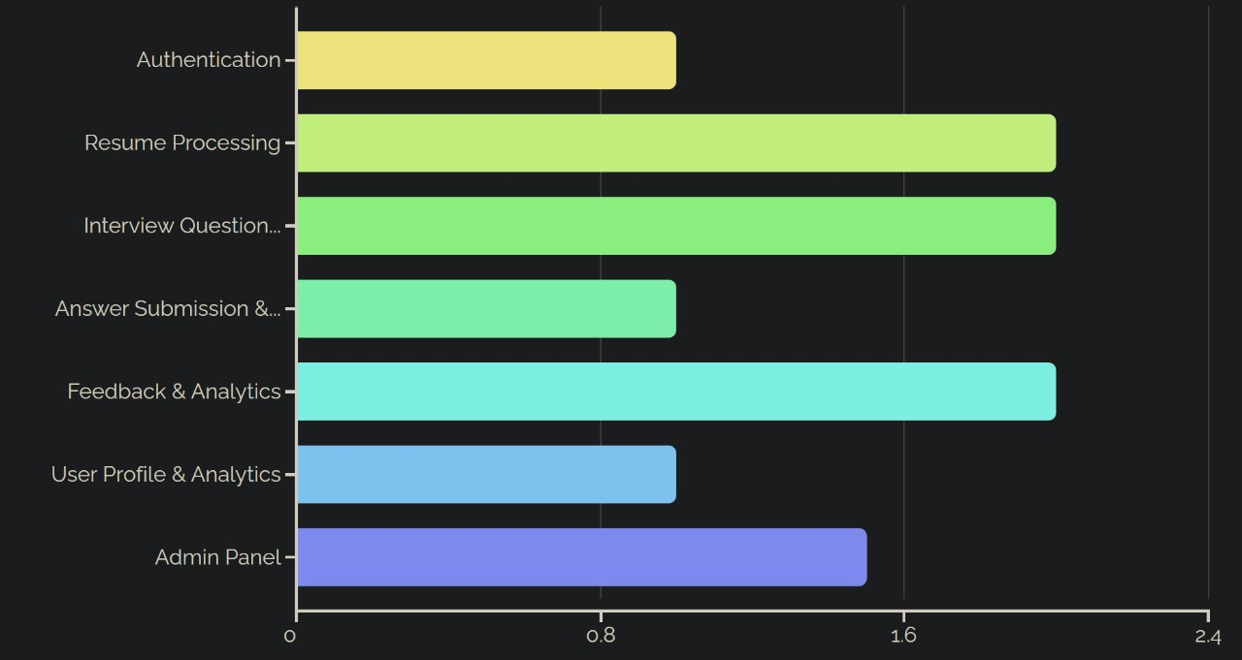
Our phased approach ensures efficient development and timely delivery of each critical module.
Timeline:
Project Timeline
This Gantt chart visualizes our 11-week development roadmap, highlighting key milestones and their allocated durations.
This Gantt chart visualizes our 14-week development roadmap, highlighting key milestones and their allocated durations.

Slide 7
Project Outcome
Final Result:
Future Scope:
Successfully developed a working platform that helps students practice effectively.
Mobile application development for greater accessibility.
Integration of adaptive learning and gamification features
Improved student engagement and performance tracking
through interactive features.
Advanced analytics using AI/ML for deeper performance insights
Expansion to cover competitive and professional exams
Delivered a solution that is scalable, reliable, and beneficial
for exam preparation.
Conclusion:
PrepGenie stands as an innovative solution to the common challenges faced by students in exam preparation. By combining personalization, regular assessments, and collaborative features, it creates an accessible and impactful learning environment. The project successfully demonstrates how technology can enhance efficiency, engagement, and outcomes in academic preparation.

Slide 8

🌍 Sustainable Development Goals (SDGs) Contribution
SDG 4: Quality Education
PrepGenie contributes to inclusive and equitable quality education by providing accessible learning resources and personalized preparation support.
It empowers students with AI-driven tools to practice, learn, and improve continuously, thereby reducing barriers to academic and career success.

Slide 9
Thank You
We sincerely thank our faculty and mentors for their continuous guidance and support throughout this project. Your attention and feedback are greatly appreciated.
✨ Prepared by Team PrepGenie

